Slide 1

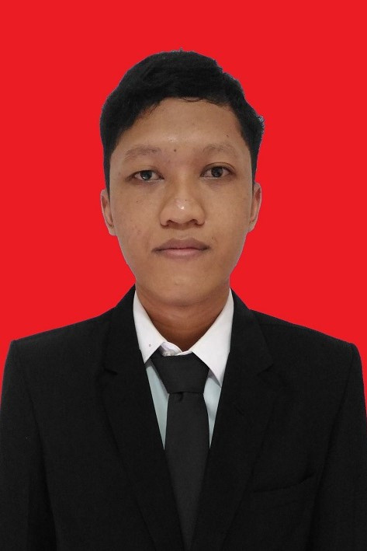
PORTFOLIO
2023
SYIDIK PRIAMBODO
ABOUT
I have experience in web developer and IT Managed Operation knowledgeable about several programming languages such as PHP and Java and also database administrators such as MySQL, PostgresSQL and Oracle database, as well as IT Management infrastructure, Platforms, CICD environment and deployment.
WORK EXPERIENCE
PT. Klik Digital Sinergi
System Administrator
( Jully 2021 - October 2023 )
Yayasan Amal Mulia Insani Web Developer
(February 2020 - August 2020 )
PT. Kreasi Jaya Utama Web Developer
(Jully 2019 - August 2019 )

Slide 2

PORTFOLIO
2023
SKILLS
PHP
Java
NodeJS
MySQL
Android Sutdio
Operating System (Linux - Windows)
Git
kubernetes
docker
CI/CD

Slide 3
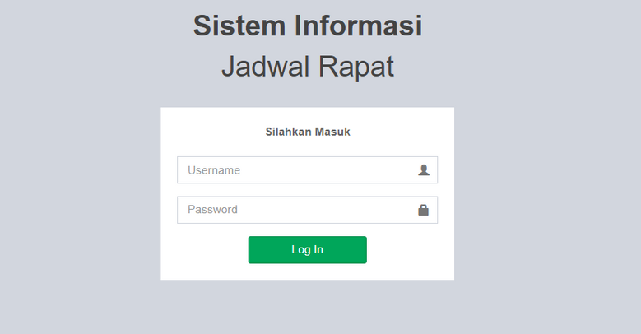
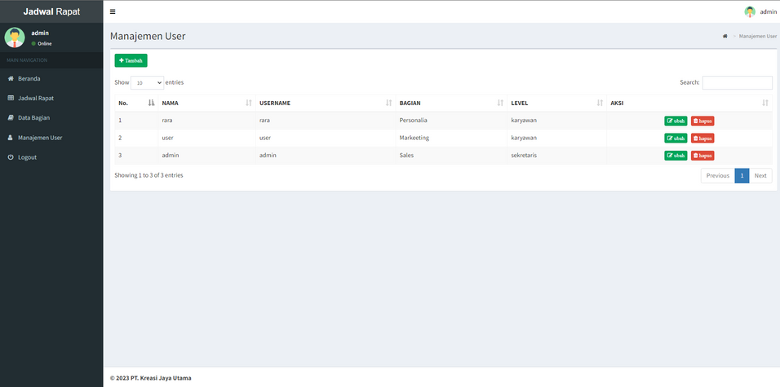
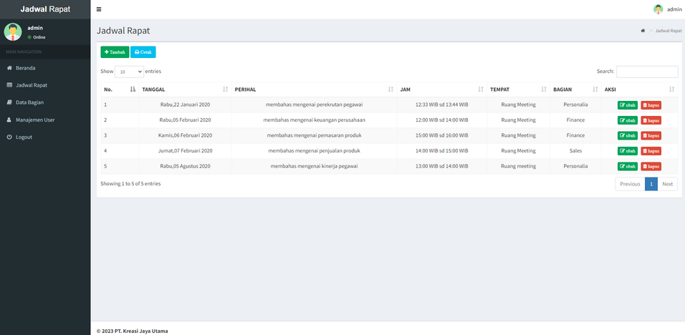
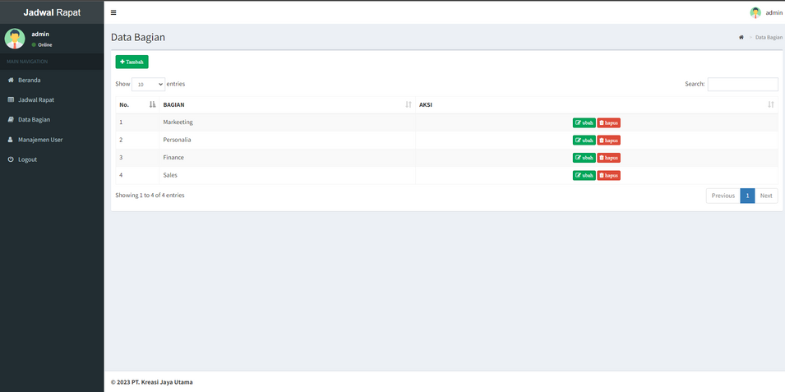
PORTFOLIO
2023
SISTEM INFORMASI PENGELOLAAN AGENDA RAPAT PADA PT. KREASI JAYA UTAMA
JULLY 2019 - AUGUST 2019
Programming Language :
PHP Program Language
Framework Codeigniter (MVC)
HTML CSS
Database MySQL
Tools :
Xampp
Visual Studio Code
Browser

Slide 4
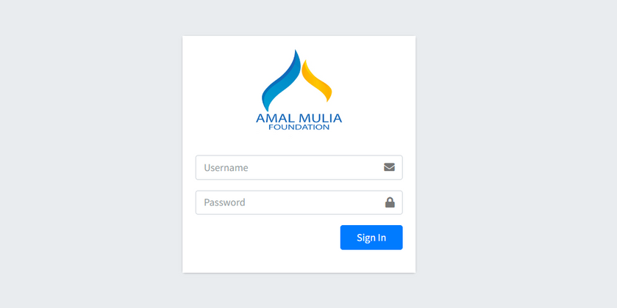
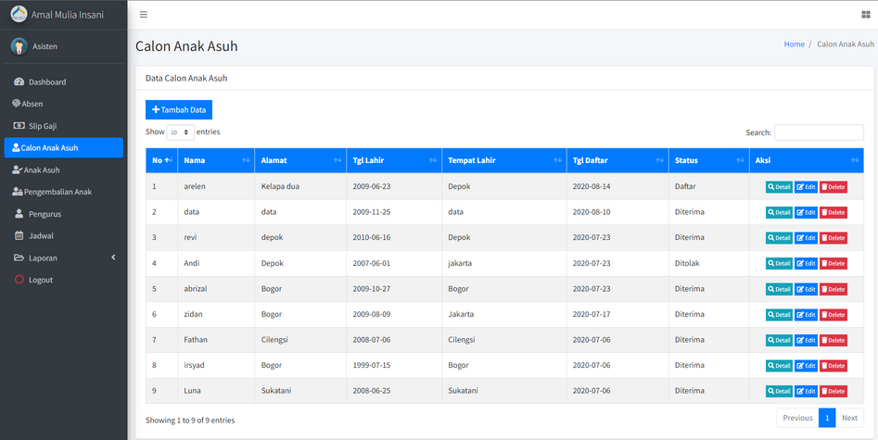
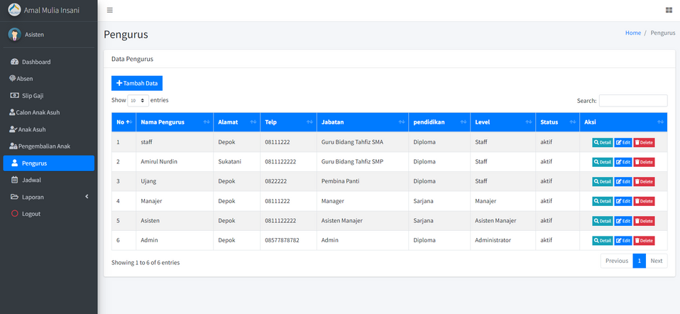
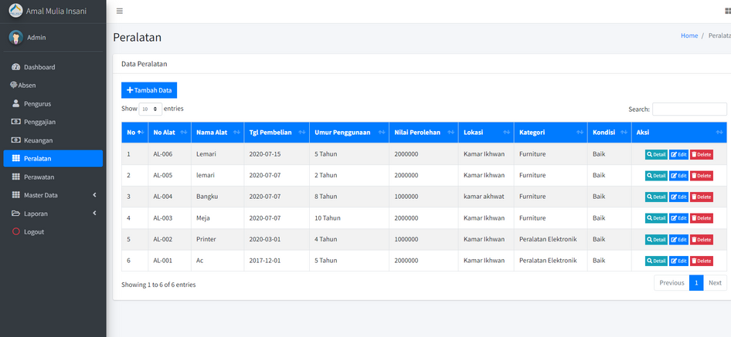
PORTFOLIO
2023
SISTEM INFORMASI PENGELOLAAN PANTI ASUHAN PADA YAYASAN AMAL MULIA INSANI DEPOK
FEBRUARY 2020 - AUGUST 2020
Programming Language :
PHP Program Language
Framework Codeigniter (MVC)
HTML CSS
Database MySQL
Tools :
Xampp
Visual Studio Code
Browser

Slide 5
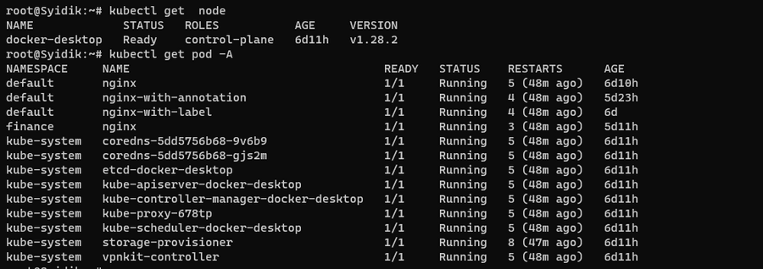
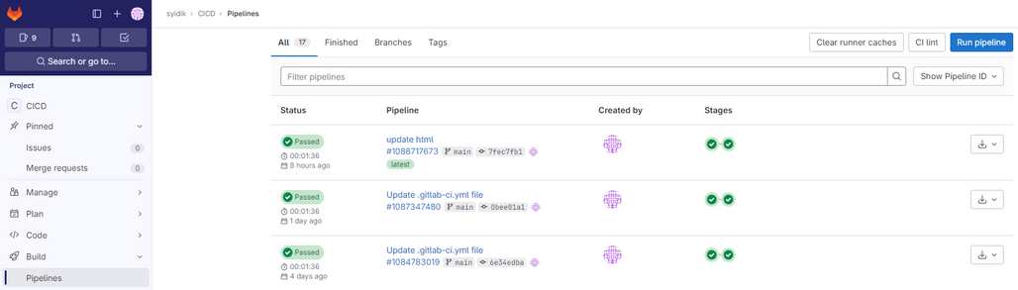
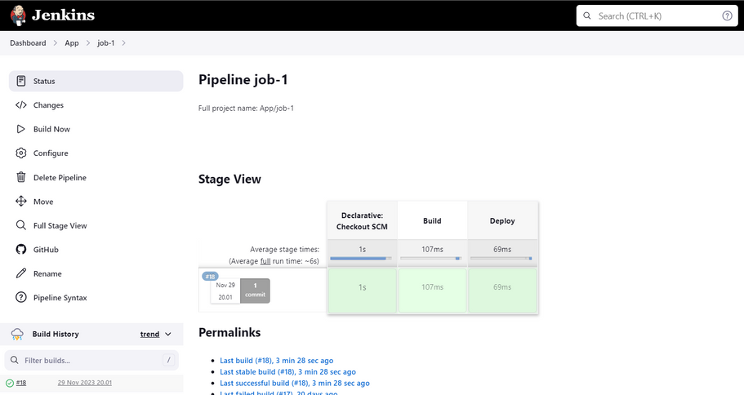
PORTFOLIO
2023
SYSTEM ADMINISTRATOR PT. KLIK DIGITAL SINERGI
JULY 2021 - OCTOBER 2023
Tools :
Kubernetes (k8s)
Gitlab
Jenkins
Jfrog
Sonarqube
Fill Task :
·Monitoring Kubernetes and troubleshoot
·Maintaining CI/CD pipeline on Gitlab and Jenkins
·Integration module / project on Gitlab to Sonarqube
·Perform service request from business through ticketing system and closing the request within SLA and ensure process quality.
·Developed an internal collaborative working environment with technical documentation, manual and
infrastructer policies
·Provide high level support primarily for end users via on-site, telephone, electronic mail, and communicate with end users

Slide 6
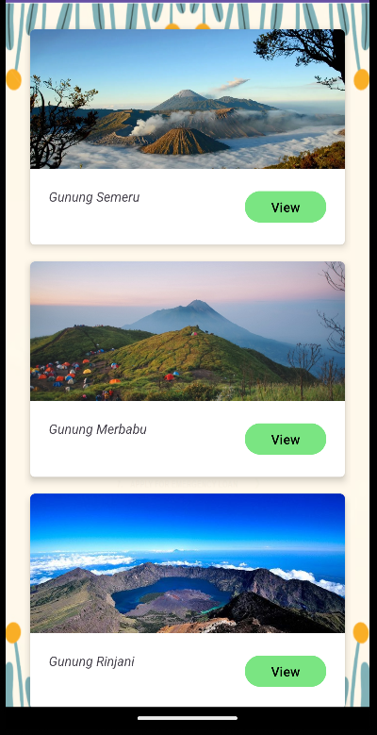
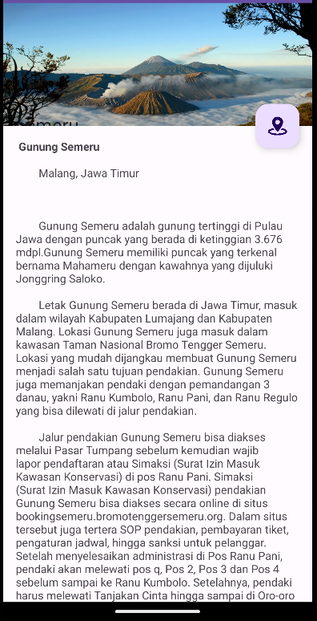
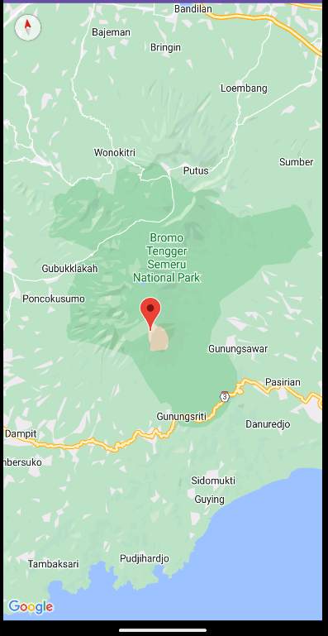
PORTFOLIO
2023
MOBILE FRONTEND APPLICATION
Programming Language :
Java Backend Program Language
Xml frontend Program Language
Tools :
Android Studio
Android Emulator
Google Cloud
Browser

Slide 7
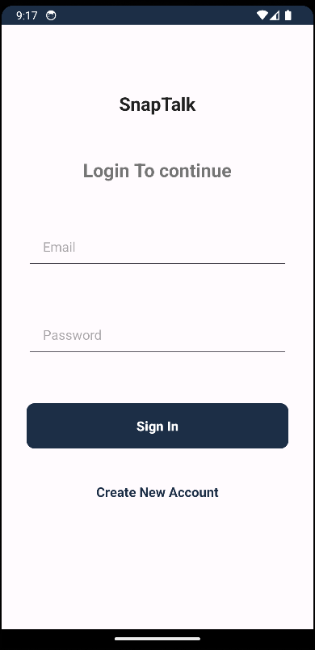
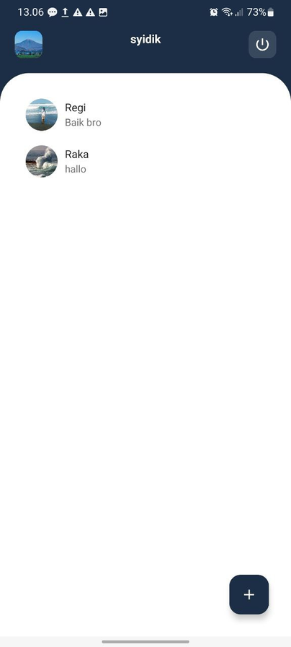
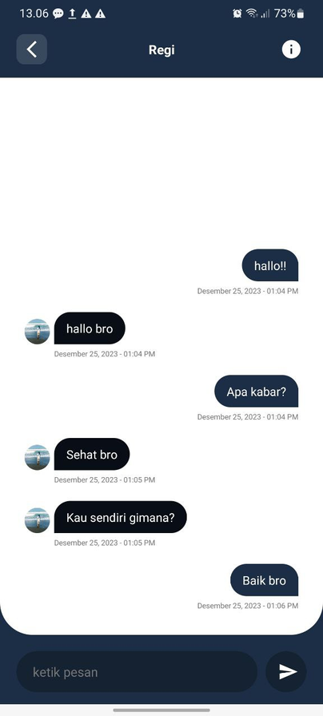
PORTFOLIO
2023
MOBILE CHATTING APPLICATION
Programming Language :
Java Backend Program Language
Xml frontend Program Language
Tools :
Android Studio
Android Emulator
Google Firebase
Browser

Slide 8
PORTFOLIO
2023
CONTACT DETAILS
EMAIL :
syidik.priam@gmail.com
PHONE :
081287165093
LINKEDIN :
https://www.linkedin.com/in/syidik-priambodo

